Slide 1
Temporal and Speciation profiles used for Fire Inventories
Review FOR YEAR 2016 EMISSIONS MODELING PLATFORM PURPOSES
J. VUKOVICH (USEPA)

Slide 2
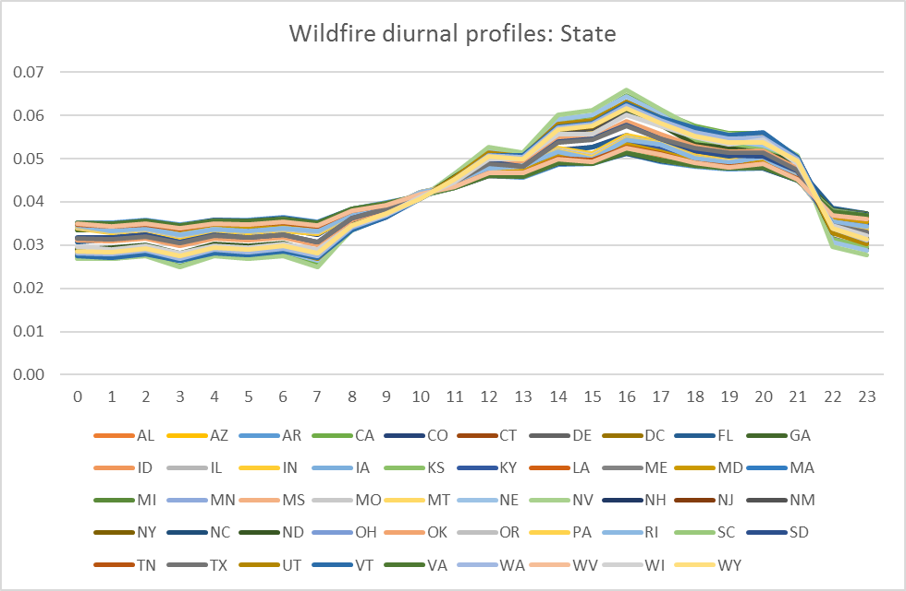
US Wildfires: Generated from older version of FEPS by state
X-axis= hours (LST)
Y-axis = Fraction of emissions assigned to this hour

Slide 3
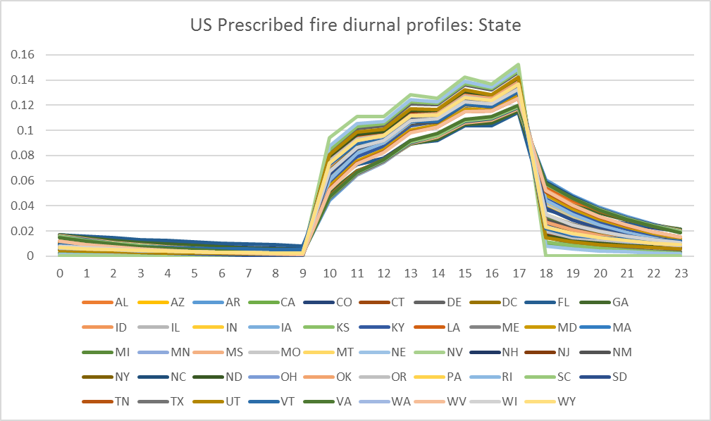
US Prescribed fires: Generated from older version of FEPS by state
X-axis= hours (LST)
Y-axis = Fraction of emissions assigned to this hour

Slide 4
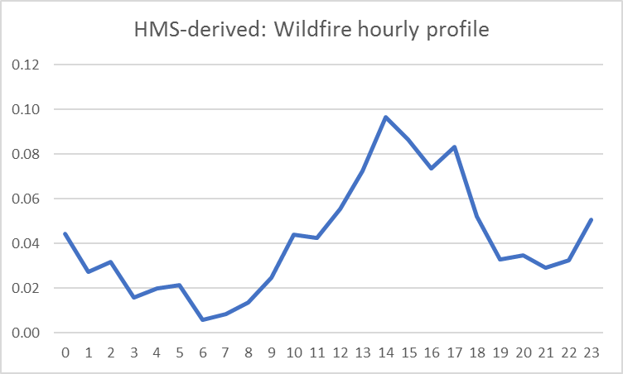
Investigating using HMS-derived profiles: Wildfires
Spikes in early morning may be due to MODIS detects; investigation continues
X-axis= hours (LST)
Y-axis = Fraction of emissions assigned to this hour

Slide 5
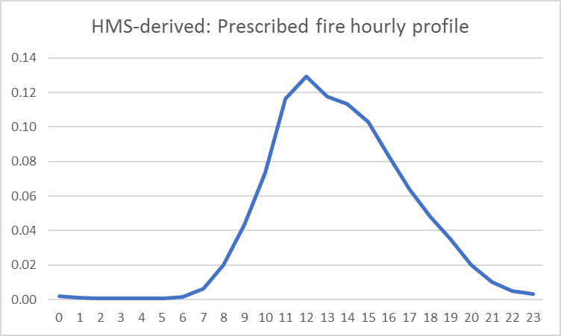
Investigating using HMS-derived profiles: Prescribed fires
May recommend this profile for Rx fires in 2016EMP modeling
X-axis= hours (LST)
Y-axis = Fraction of emissions assigned to this hour

Slide 6
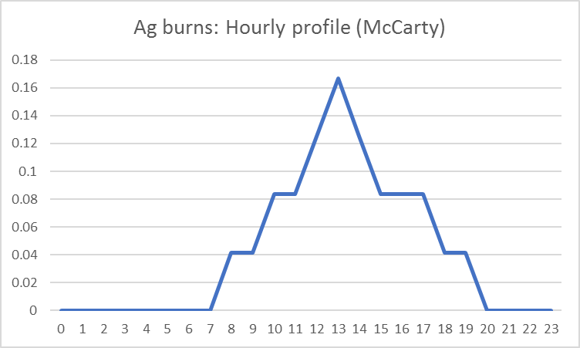
Ag fires: McCarty ; used for US and non-US
X-axis= hours (LST)
Y-axis = Fraction of emissions assigned to this hour

Slide 7
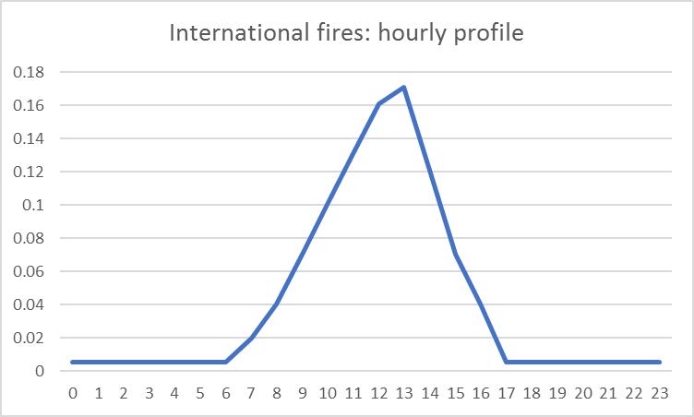
International fires: non-ag fires
Unable to distinguish between Wildfires and Prescribed fires with FINN inventory
X-axis= hours (LST)
Y-axis = Fraction of emissions assigned to this hour

Slide 8
TOG speciation profiles: CB6 species

Slide 9
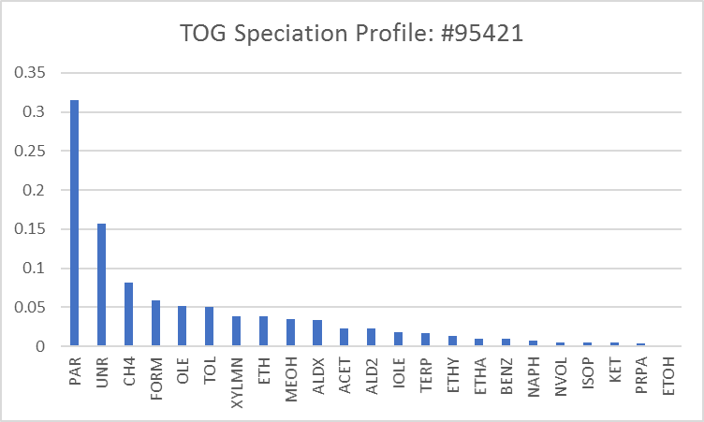
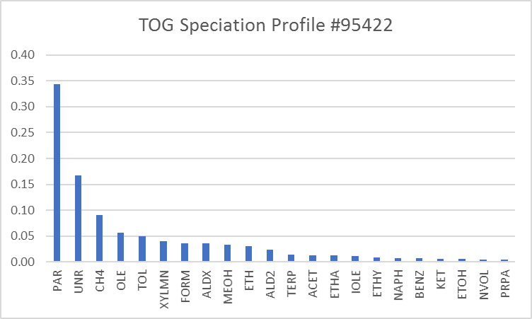
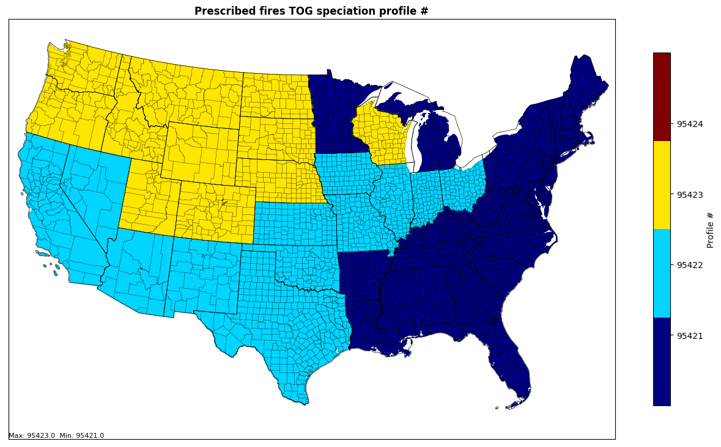
TOG speciation profiles: US Prescribed fires

Slide 10
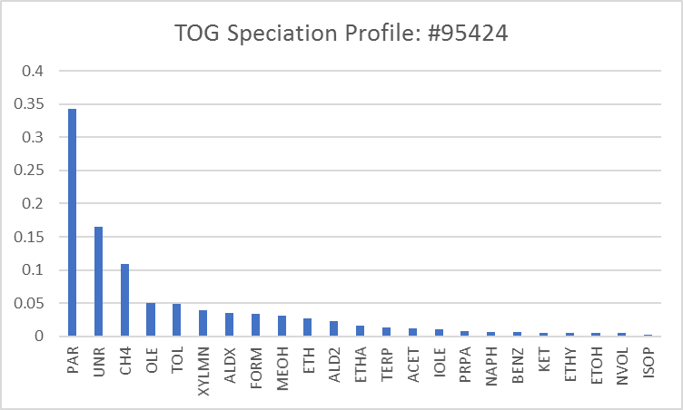
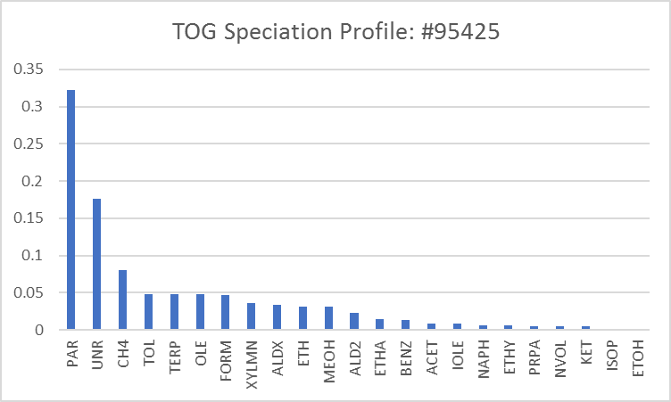
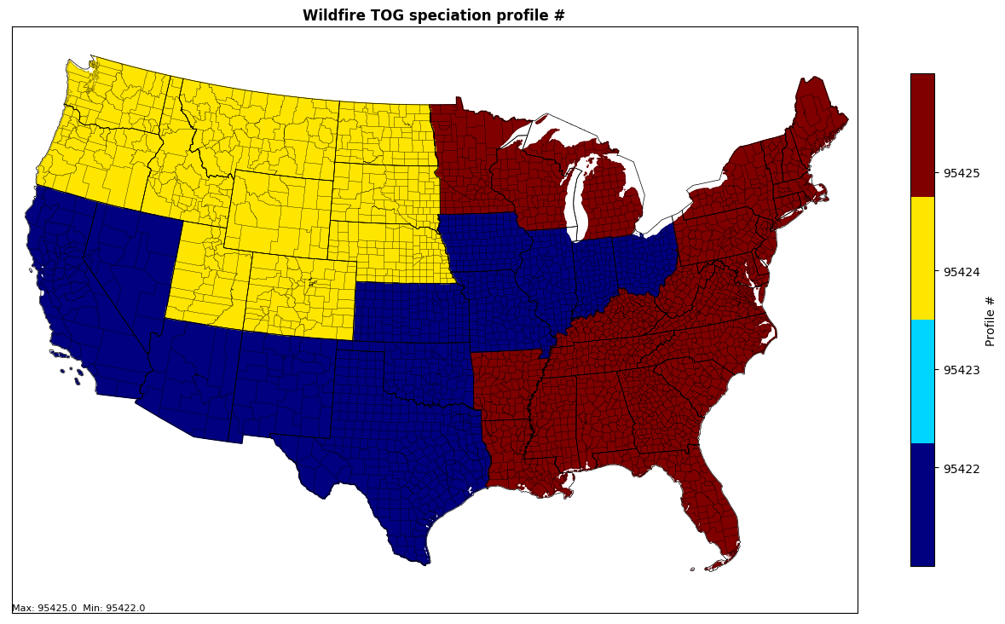
TOG speciation profiles: US Wildfires

Slide 11
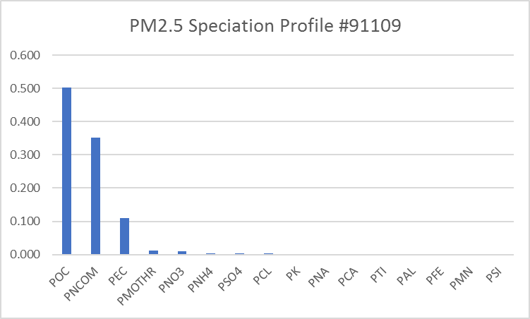
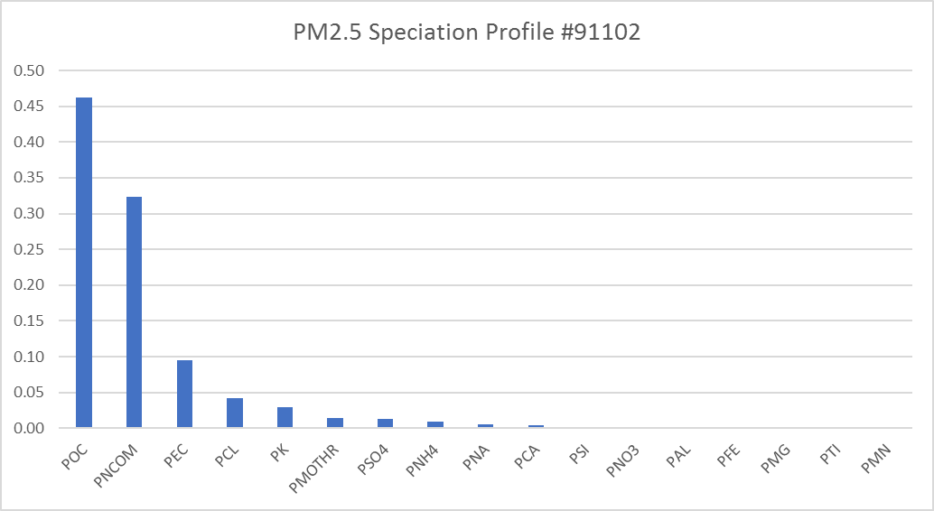
PM2.5 speciation profiles: USA
Prescribed Fires
Wildfires

Slide 12
PM2.5 speciation profiles: Species

Slide 13
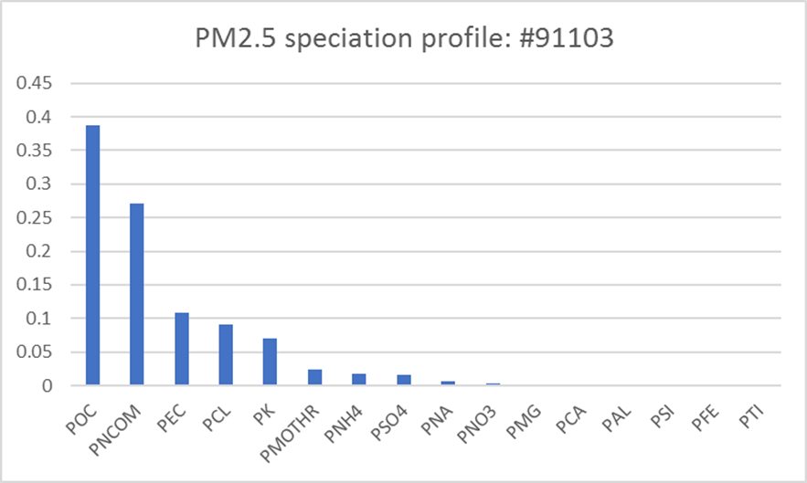
PM2.5 speciation profiles: USA
All agricultural burns/grassland fires outside of SF/Blue Sky

Slide 14
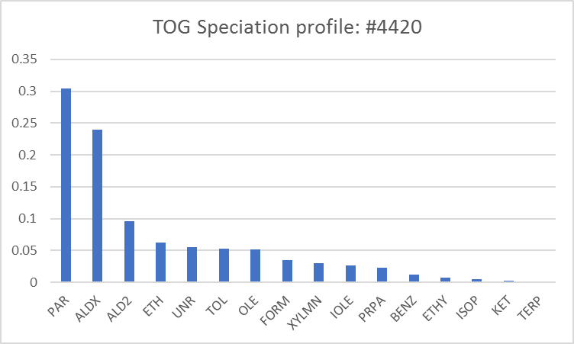
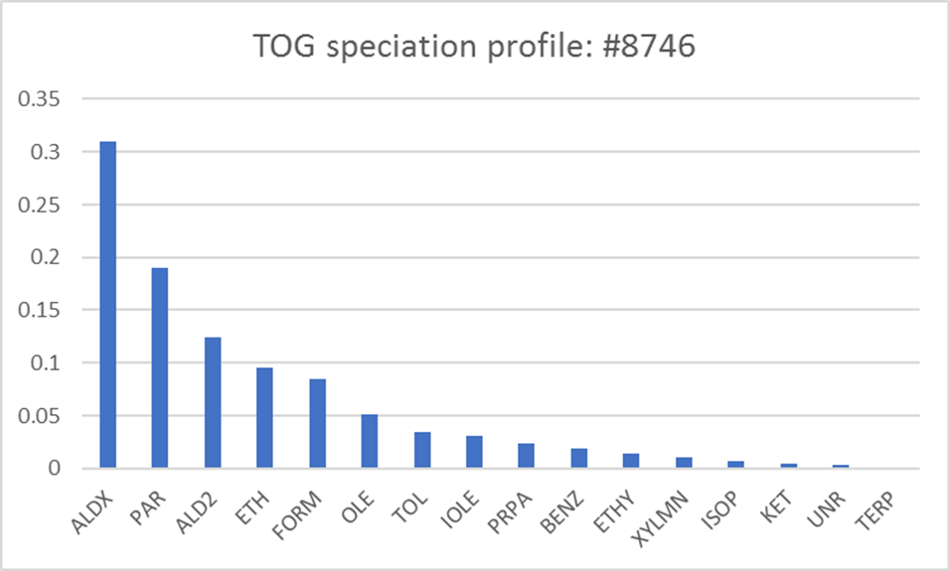
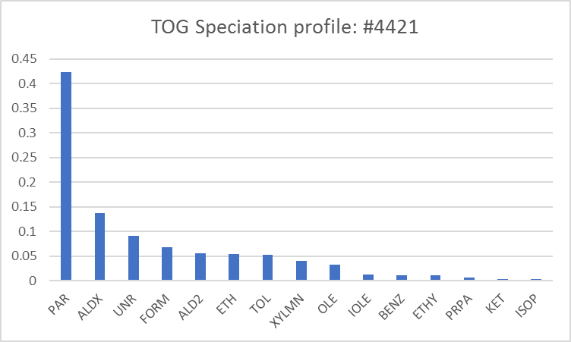
Rice
TOG speciation profiles: USA Agricultural burns
Beans, Corn, Winter Wheat/Corn, Corn/Soybeans, Cotton, Grasses, Fallow, Sugar Cane, Unspecified crop
Wheat, Winter Wheat/Cotton, Winter Wheat/Soybeans

Slide 15
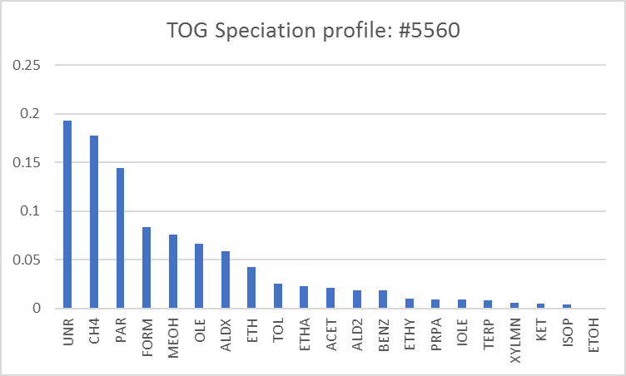
TOG speciation profiles: outside of USA
Agricultural burns
Wildfires/all other

Slide 16
PM2.5 speciation profiles: outside of USA
Agricultural burns
Wildfires/all other

